Slide 1


Titolo presentazione sottotitolo
ELOBO: An Efficient Leave-One-Block-Out Outlier Detection Tool
Milano, XX mese 20XX
GIS Project
Prof. Ludovico Biagi
Co-Pro.f Mariagrazia Fugini
10973015
DENG JIANWEI

Slide 2

1. Background & Objective 2. Methodology Overview 3. Efficient ELOBO Algorithm 4. System Implementation 5. Results & Visualization 6. Conclusion & Future Improvements
Contents

Slide 3
1. Background & Objective
Challenge:
Traditional point-wise outlier detection fails when observations are correlated (e.g., in geodetic networks or sensor arrays).
Especially when the covariance matrix is ​​complex (non-unit matrix) or the observation correlation is high, the traditional least squares method and classic anomaly detection methods often fail or are inefficient.
Goal:
Efficiently detect abnormal blocks of observations under correlation.
Including：Faster computation,
Block-level outlier precision,
Scalable to large, correlated systems

Slide 4
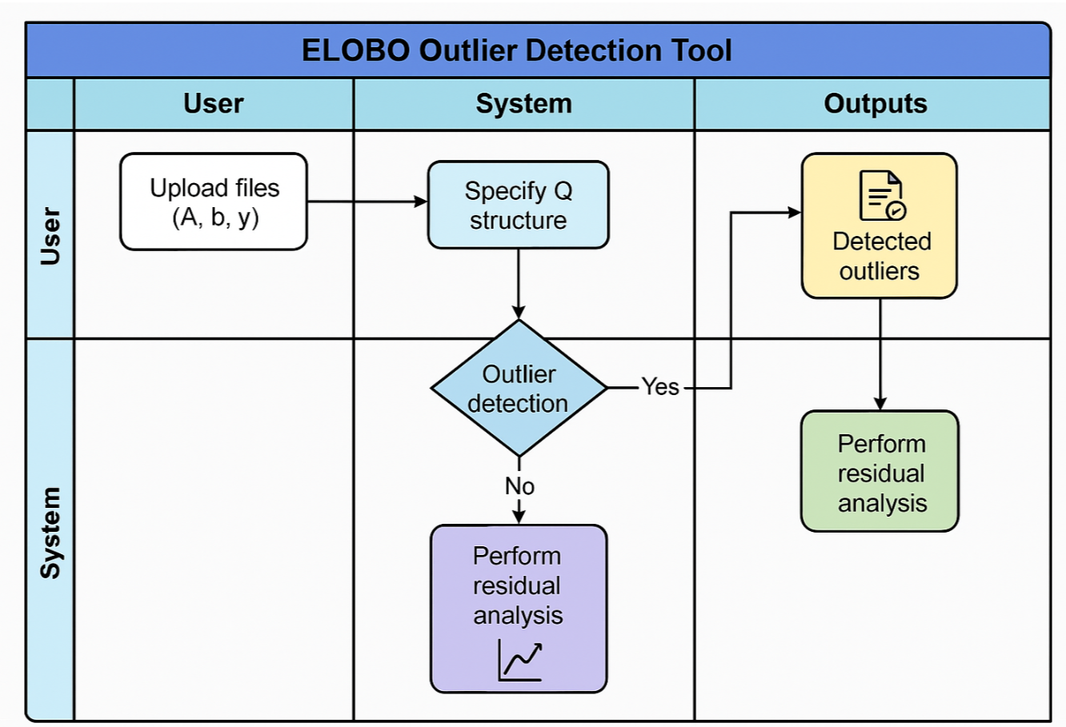
2. Methodology Overview
Set an interactive web-based tool using Streamlit that allows users to efficiently detect outliers in correlated observation data by applying the ELOBO method.
Content：
· User uploads data (A, b, y) and Q structure settings
· Allow flexible definition of weight matrix Q,
including: identity, diagonal, block-diagonal,fully populated.
· Perform LS estimation under generalized covariance structure.
· Extract block structures from Q using graph-based methods (DFS).
· Perform Leave-One-Block-Out analysis for each block.
· Detect blocks as outliers based on residual norm changes.
· Output residual plots, detected outliers, and exporting of results.

Slide 5
2. Methodology Overview
Purpose: Provide an overview of the method flow and module division.
Key Components:
Block Structure Extraction: The algorithm uses a Depth-First Search (DFS) approach to identify block structures in the covariance matrix Q, enabling localized outlier analysis.
Efficient Computation: Instead of refitting the model multiple times per block, the method leverages efficient matrix decompositions (e.g. inverse reuse and partial updates) to reduce computational cost while preserving accuracy.

Slide 6
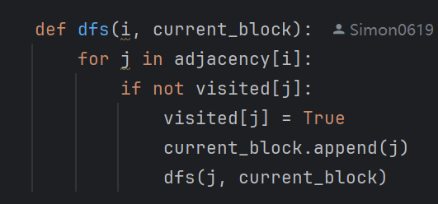
3. Efficient ELOBO Algorithm
Block Structure Extraction: Using DFS to traverse the adjacency graph (the connectivity defined by the non-zero elements in Q) and identify a connected block.
The adjacency graph is extracted from the block structure and a depth-first search is performed to identify subsets of observations that are associated with each other. The subsets are then used as "blocks" in the ELOBO method for independent outlier evaluation.

Slide 7
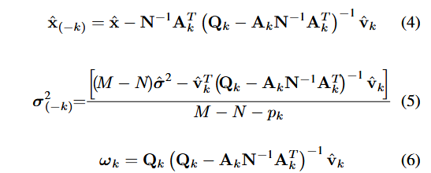
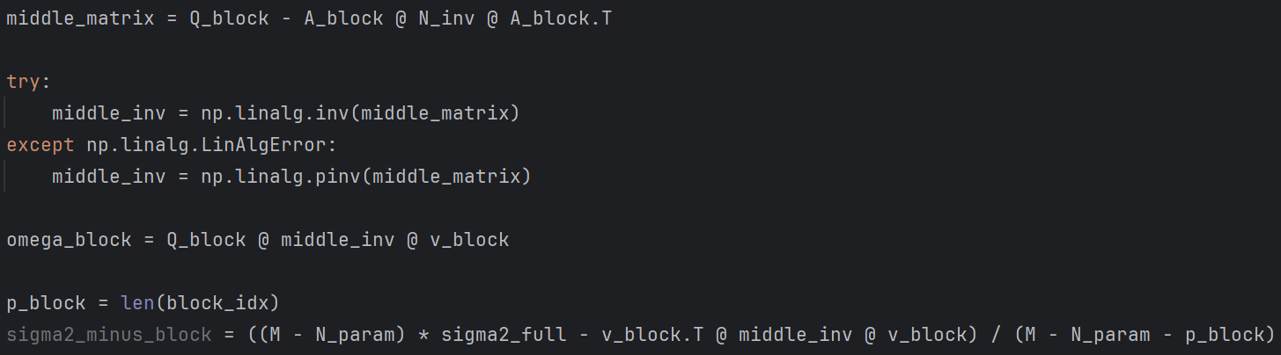
3. Efficient ELOBO Algorithm
The ω vector measures the residual perturbation of each block, while the culled σ² estimate enhances robustness.
This enables fast outlier detection without re-estimating the full model.

Slide 8
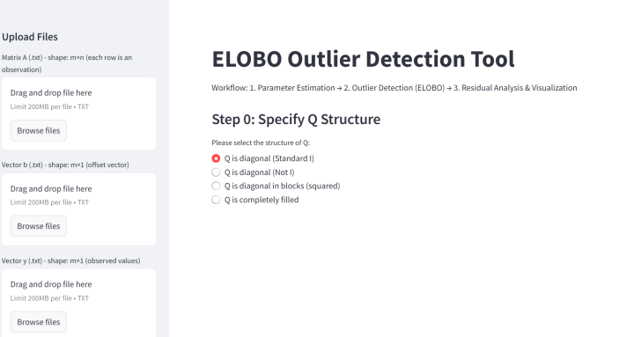
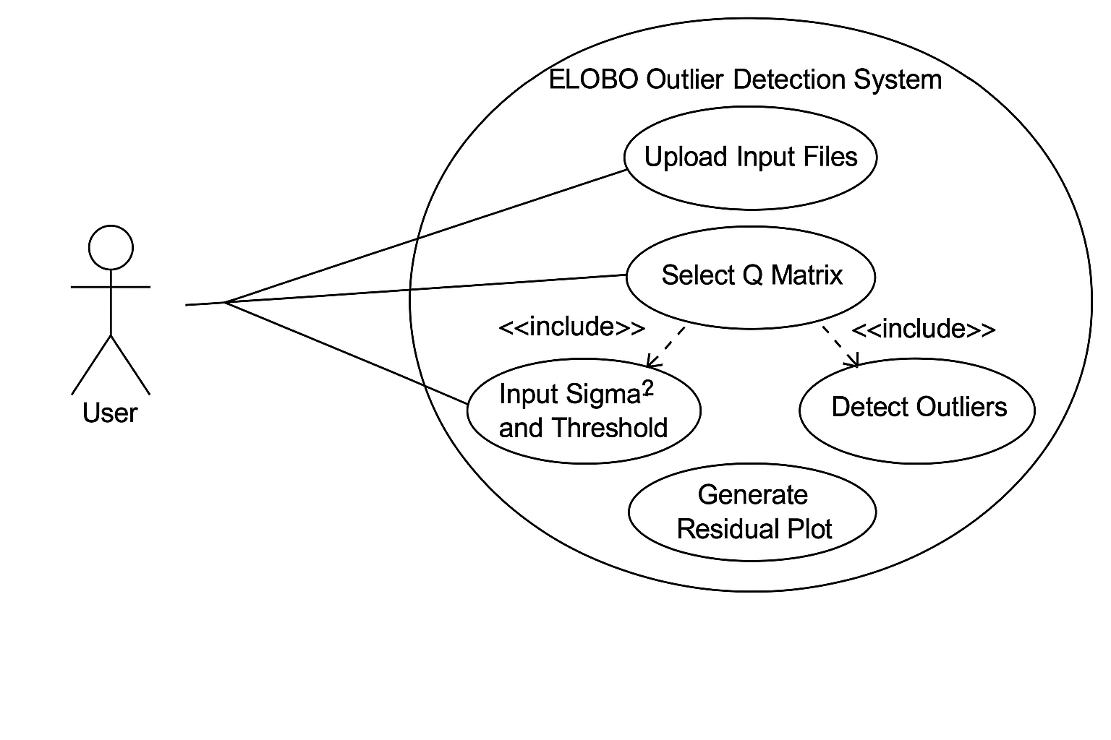
4. System Implementation
Language used: Python 3.10(Over 3.8 is Ok);
Core libraries: Streamlit, NumPy, Pandas, Matplotlib;
File structure description (elobo_project.py, test_elobo.py(optional));

Slide 9
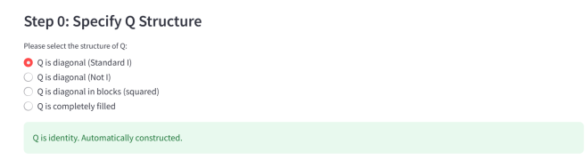
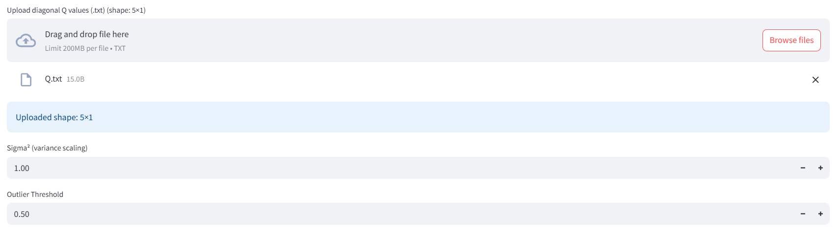
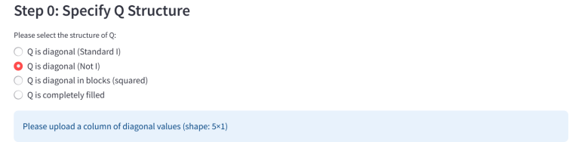
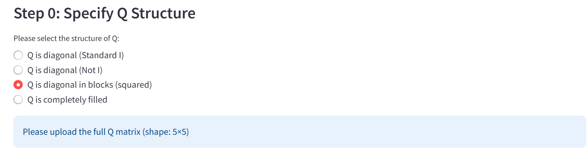
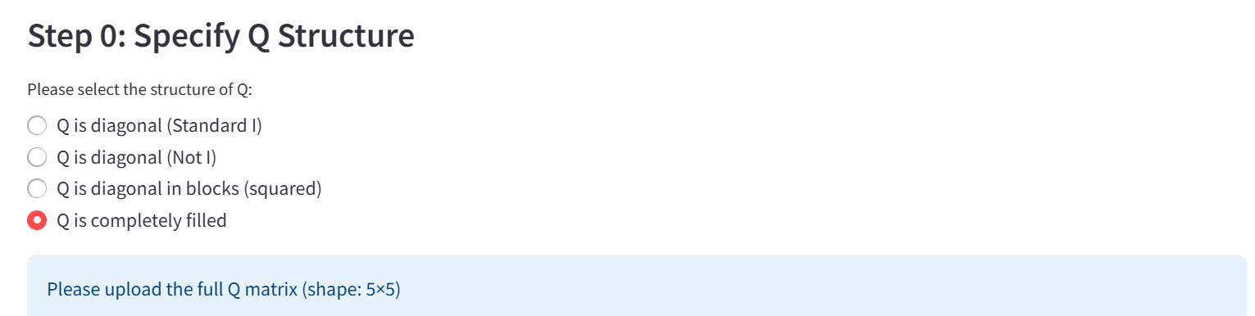
4. System Implementation
Select Q type → Automatically generate input → Set parameters (σ² and threshold)
σ² (variance factor): Scaling the covariance matrix
Outlier threshold:determine the sensitivity of the ω-based detection

Slide 10
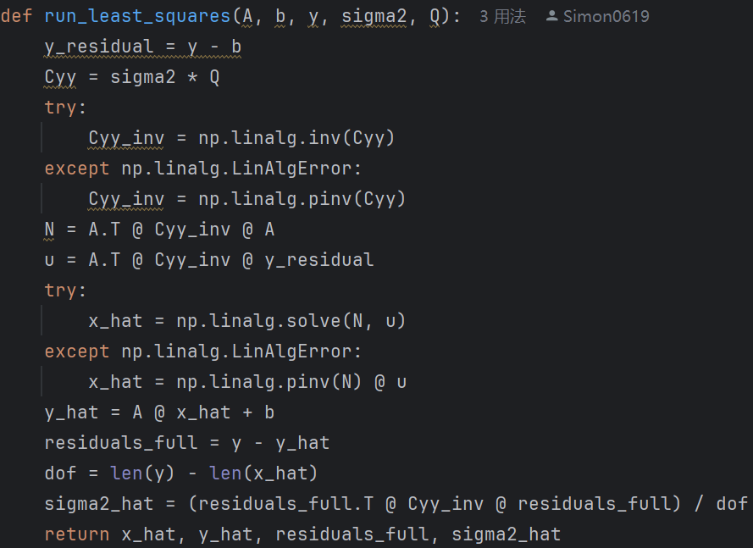
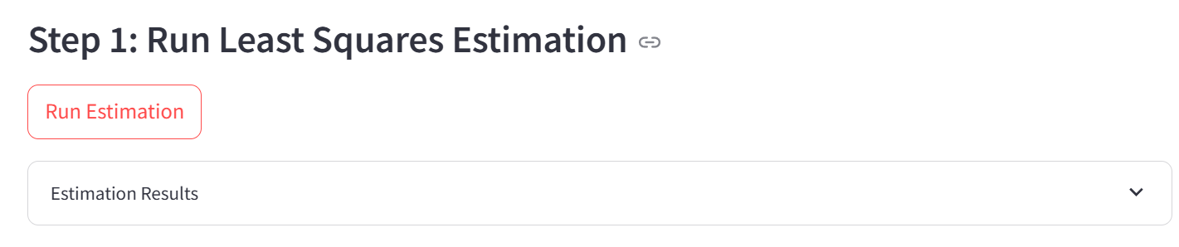
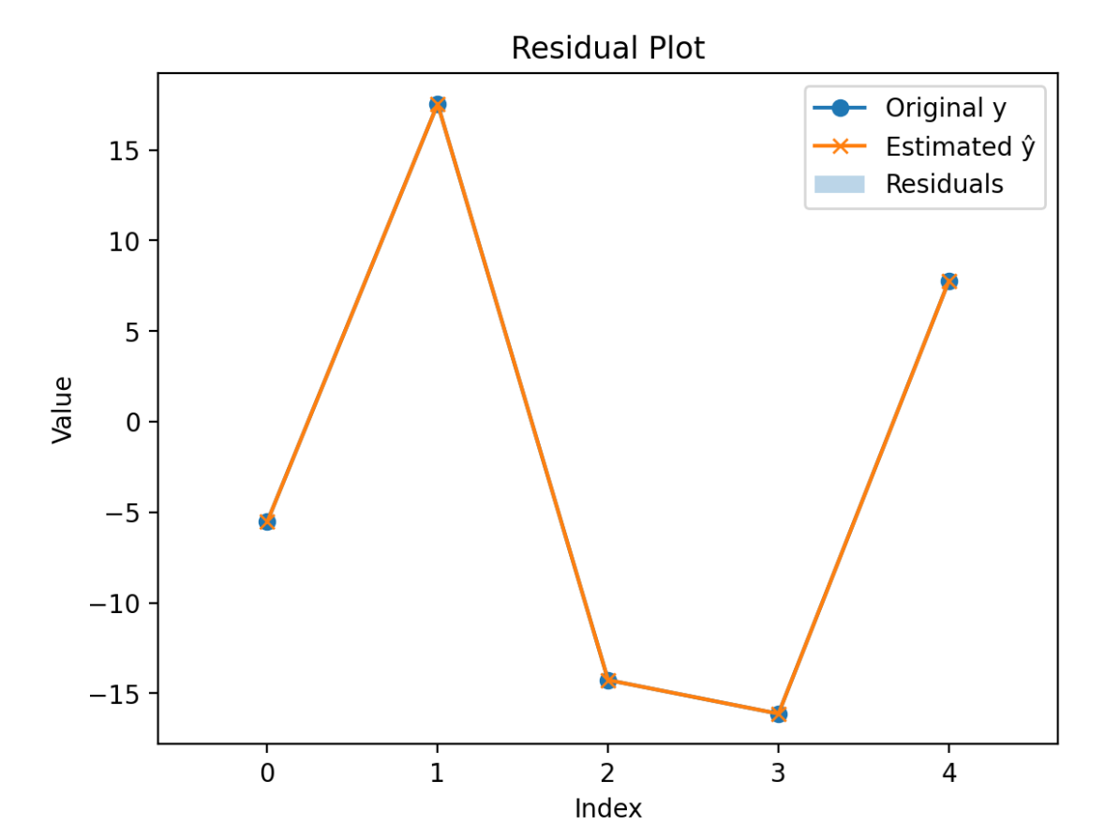
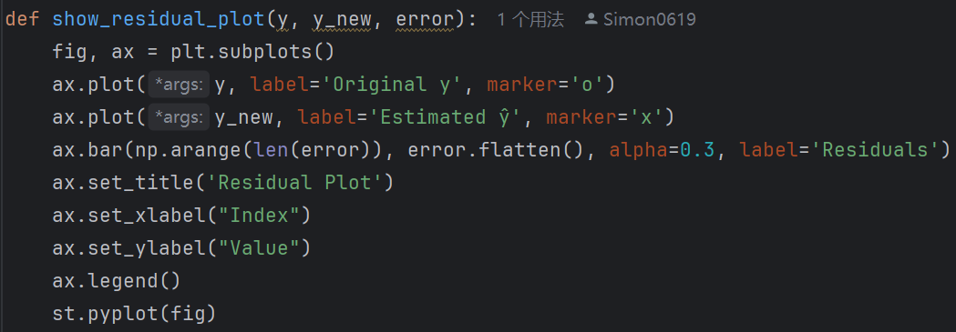
5. Results & Visualization

Slide 11
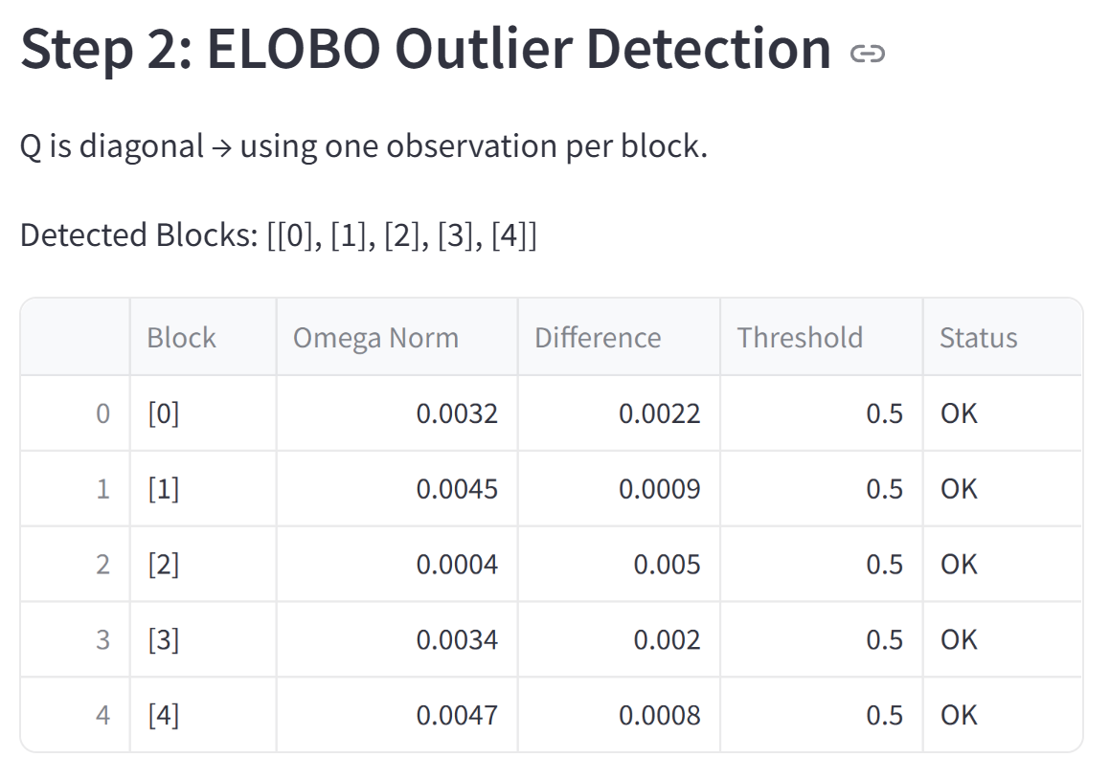
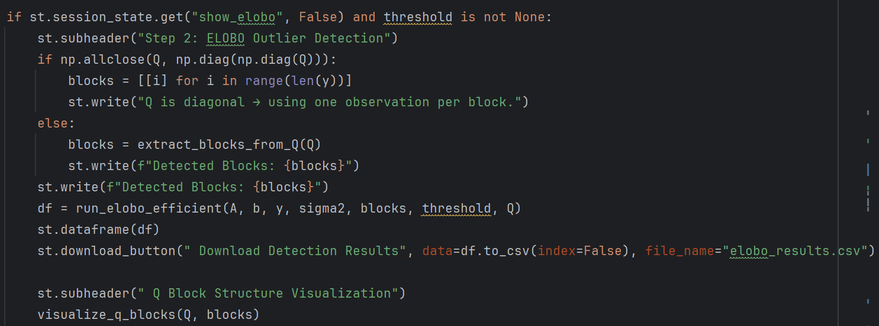
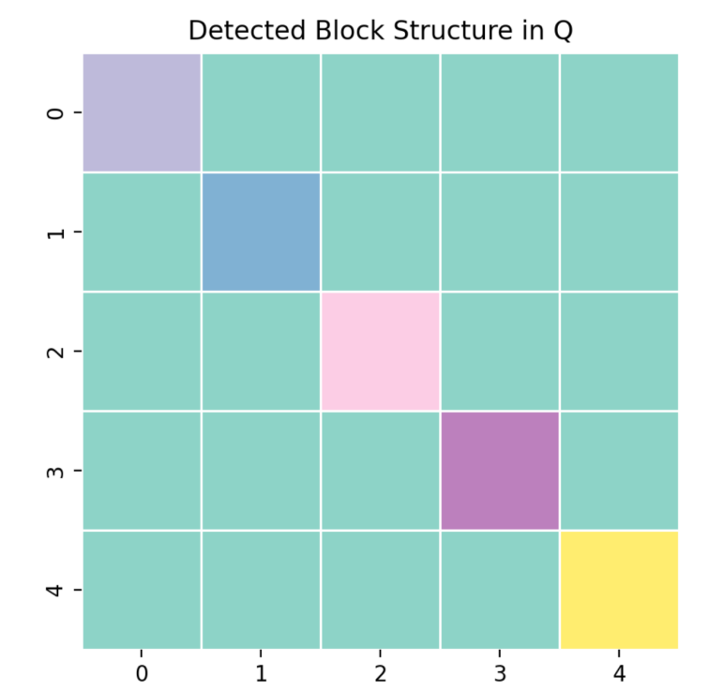
5. Results & Visualization
1.Determine the structure of Q and construct blocks；
2.Execute the ELOBO core detection algorithm；
3.Download the detection results；
4.Visualize the block structure of Q；

Slide 12
6. Conclusions and Future Work
Contributions：
Implemented a complete and efficient ELOBO outlier detection tool；
Supports user-defined A, b, y, Q inputs (user-friendly interface)；
Four types Q structures: identity, diagonal, block diagonal,fullfilling；
Automatically extract blocks using graph-based depth-first search (DFS)
Interactive Streamlit interface for real-time visualization and export；
Limitations：
Q type must be selected before estimation；
Does not support online data；
No statistical tests and other analyses on outlier results；
Future improvements：
Optimized for large datasets；
Refactored as modular Python components；
Added statistical tests and multivariate tools；

Slide 13
Thanks for your attention!

